Slide 1

Wireshark 操作

Slide 2
Introduction
免費且開源
網路偵錯、分析等等

Slide 3
UI

Slide 4
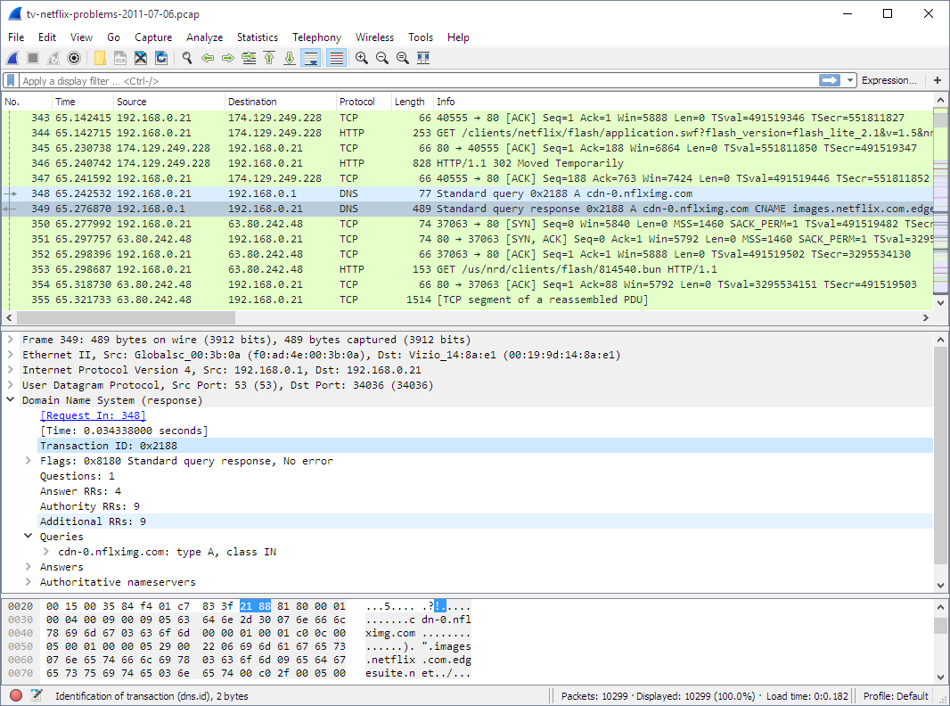
UI
Menu
Main toolbar
Filter toolbar
Packet List pane
Packet Details pane
Packet Bytes pane

Slide 5
Filter

Slide 6
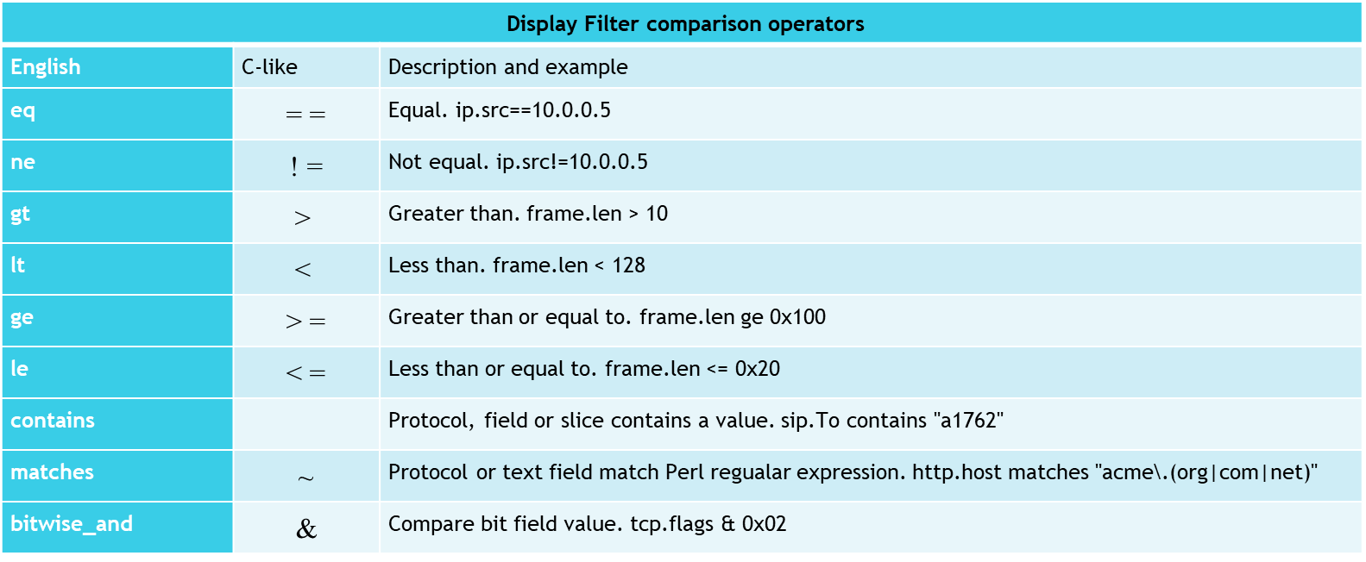
Filter

Slide 7
OSI

Slide 8
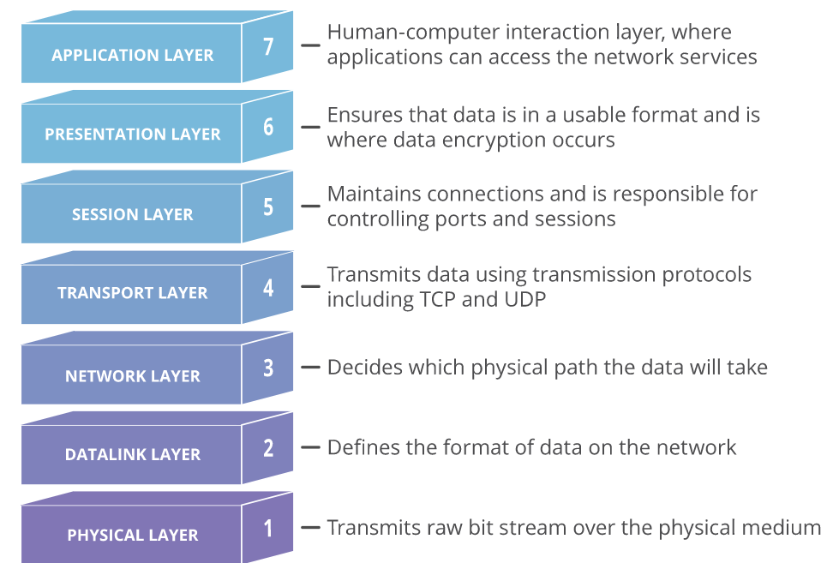
OSI

Slide 9
Capture skills

Slide 10
MAC

Slide 11
ether src {Host MAC Address}
捕捉來源為 Host MAC Address 的資料
ether dst {Host MAC Address}
捕捉目的地為 Host MAC Address 的資料

Slide 12
IP

Slide 13
src host {IP Address}
捕捉來源來自 {IP Address} Host 上資料
dst host {IP Address}
捕捉目的來自 {IP Address} Host 上資料

Slide 14
Port

Slide 15
udp port 67
捕捉來自/到達 Port 67 的 UDP 資料
portrange 1-80
捕捉來自/到達 Port 1-80 的 UDP/TCP 資料

Slide 16
Tool

Slide 17
Display filter

Slide 18
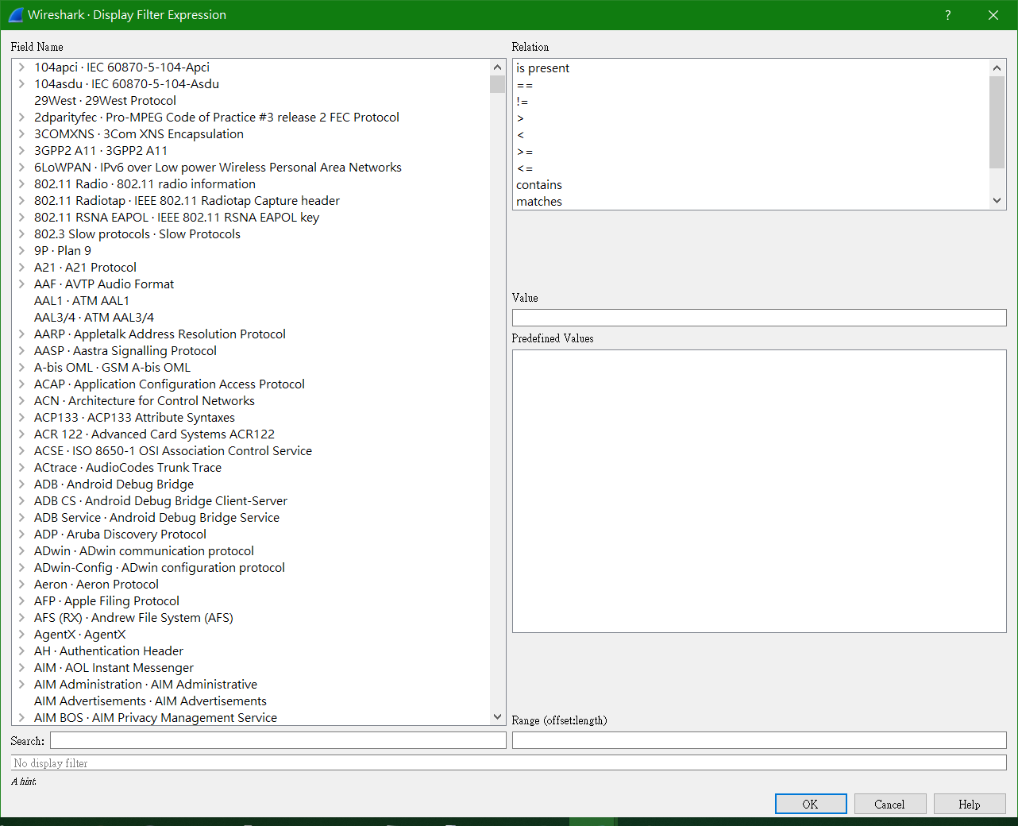
點選 Expression

Slide 19
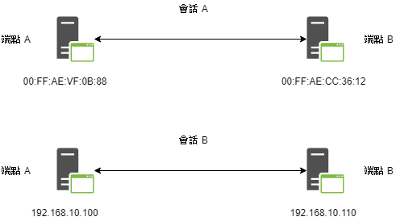
Endpoints
端點指的是網路上收發資料的個裝置；會話指的是兩個端點之間的通訊。

Slide 20
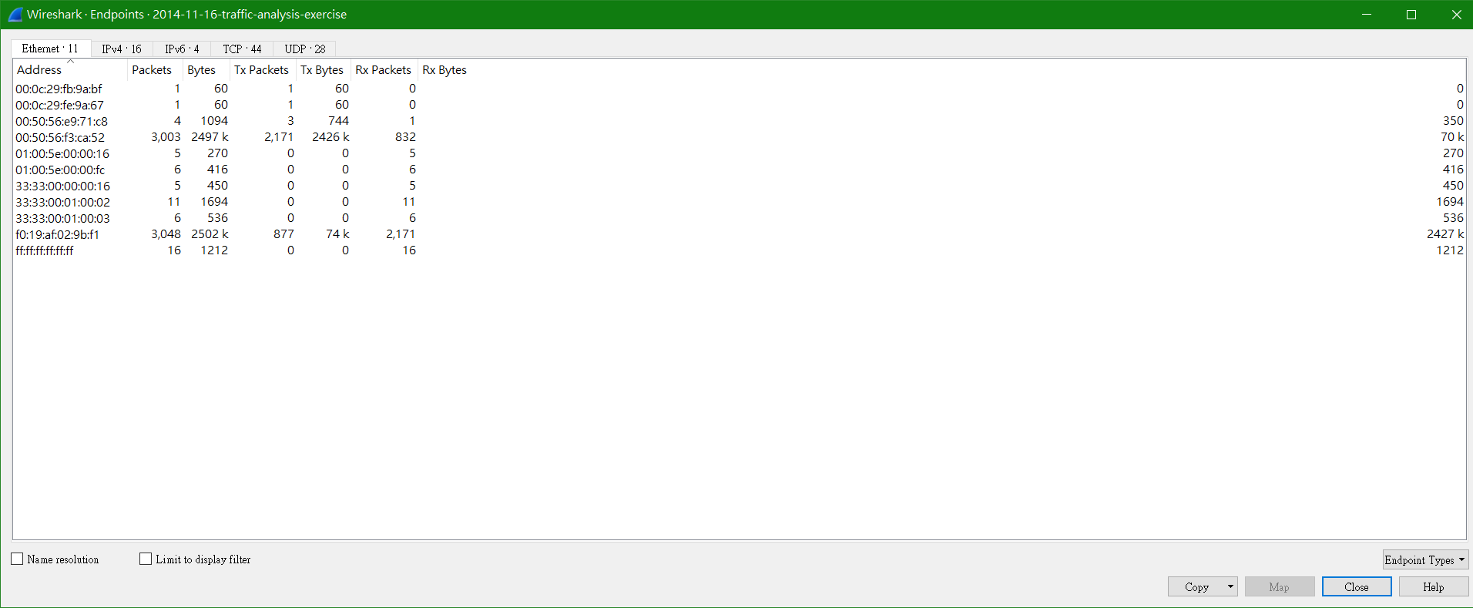
Statistic -> Endpoint

Slide 21
Conversations

Slide 22
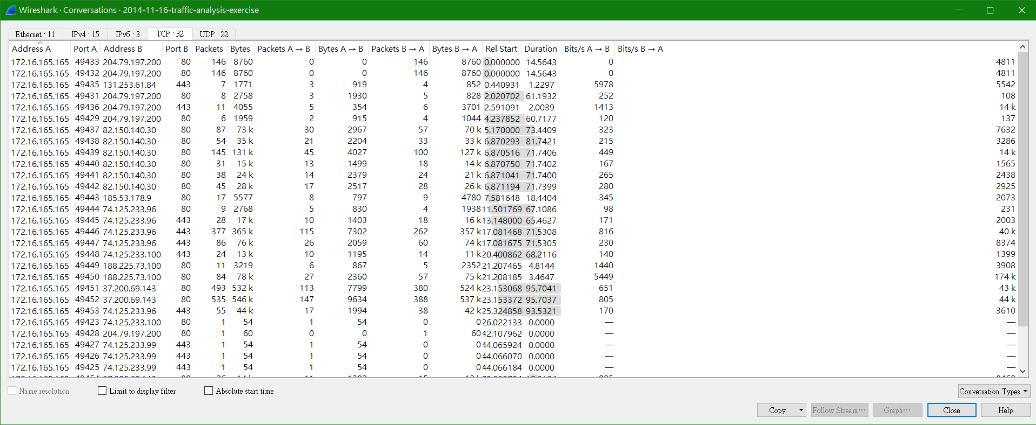
欄位 Address A 表示會話發起點，欄位 Address B 表示會話目的地。 透過檢視看到發送的封包流量，再透過篩選器去過濾。

Slide 23
Protocol Hierarchy
對一個陌生的捕捉流量結果，有時必須借助流量中的協定分布狀況來判斷。透過 wireshark 的協定的階層式統計可以發掘 TCP、IP、DHCP 和其它協定的流量分別占用了多少。

Slide 24
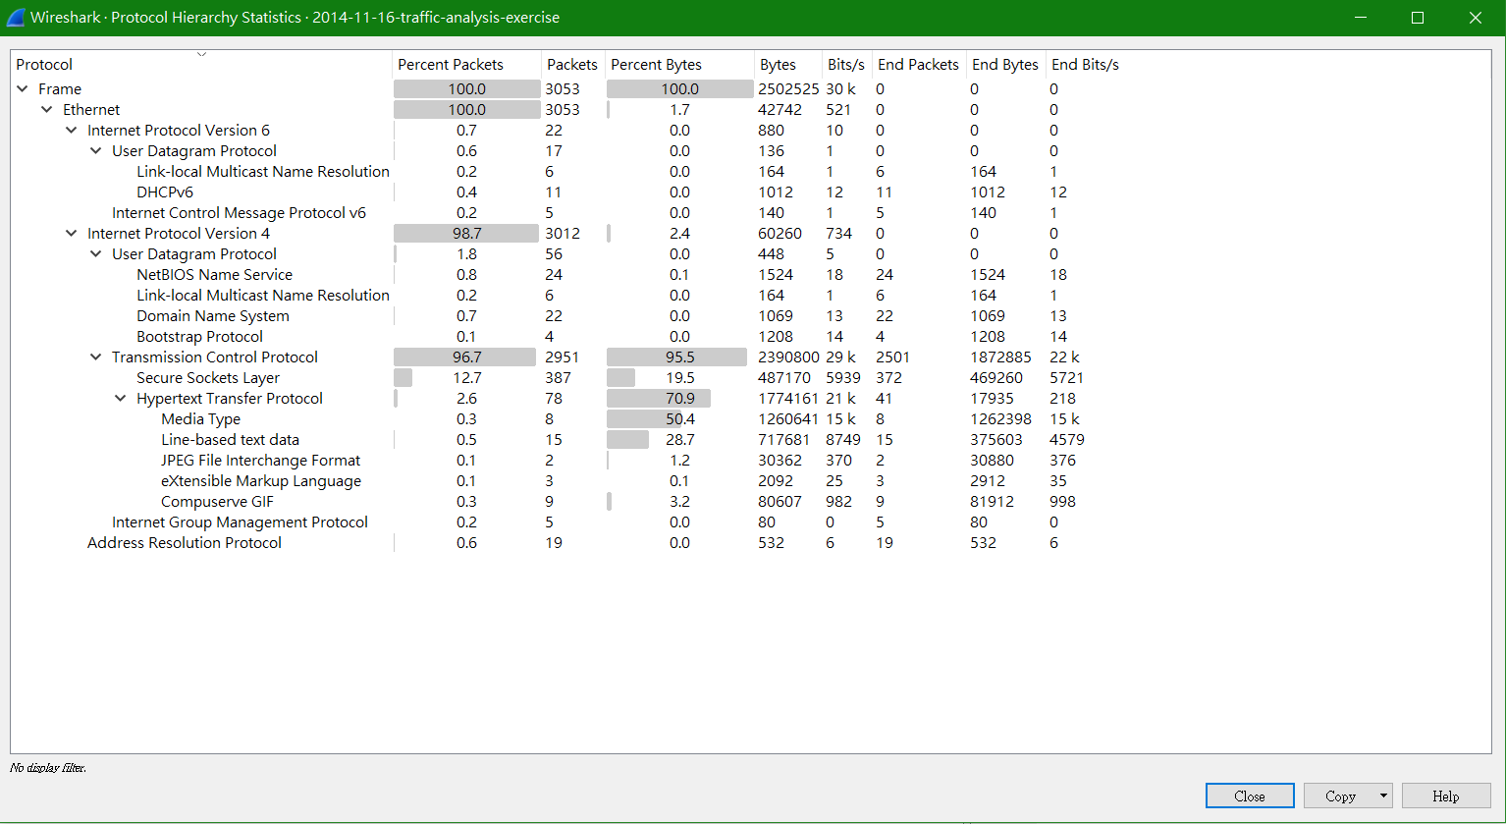
Statistics -> Protocol Hierarchy

Slide 25
Flow Graph
對於檢視資料隨時間而流動的過程，圖中裡資訊可以更清楚看出裝置之間如何通訊。

Slide 26
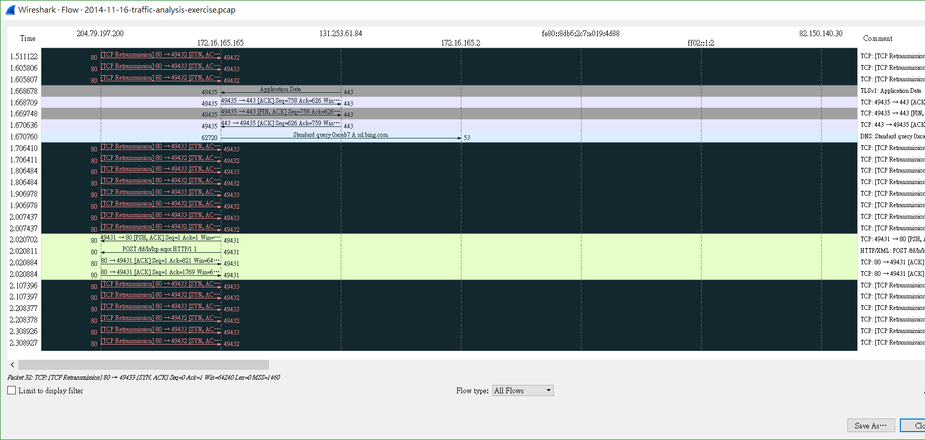
Statistics -> Flow Graph

Slide 27
ARP Example

Slide 28
ARP Header
Offsets | Octet | 0 |  |  |  |  |  |  |  | 1 |  |  |  |  |  |  |  | 2 |  |  |  |  |  |  |  | 3
Octet | Bit | 0 | 1 | 2 | 3 | 4 | 5 | 6 | 7 | 8 | 9 | 10 | 11 | 12 | 13 | 14 | 15 | 16 | 17 | 18 | 19 | 20 | 21 | 22 | 23 | 24 | 25 | 26 | 27 | 28 | 29 | 30 | 31
0 | 0 | Hardware type |  |  |  |  |  |  |  |  |  |  |  |  |  |  |  | Protocol type
4 | 32 | Hardware address length |  |  |  |  |  |  |  | Protocol address length |  |  |  |  |  |  |  | Opcode
8 | 64 | Source hardware address
12 | 96 | Source protocol address
16 | 128 | Destination hardware address
20 | 160 | Destination protocol address
24 … | 192 … | Data

Slide 29
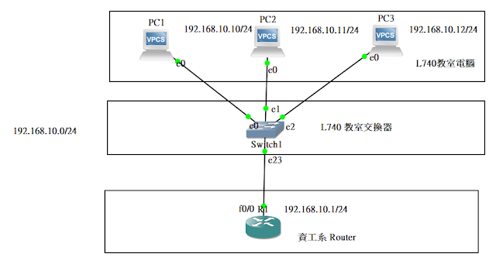

Slide 30
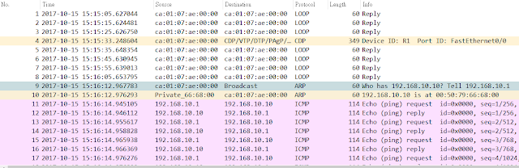

Slide 31
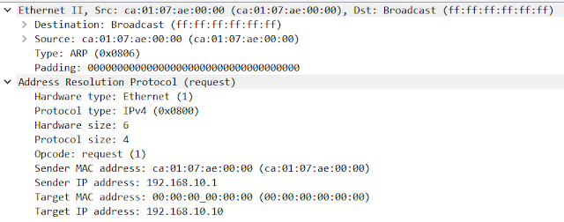

Slide 32
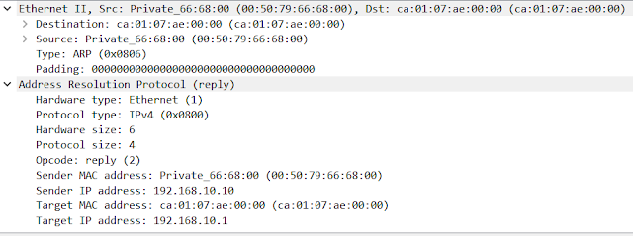

Slide 33
ICMP Example

Slide 34
ICMP Header
Offsets | Octet | 0 |  |  |  |  |  |  |  | 1 |  |  |  |  |  |  |  | 2 |  |  |  |  |  |  |  | 3
Octet | Bit | 0 | 1 | 2 | 3 | 4 | 5 | 6 | 7 | 8 | 9 | 10 | 11 | 12 | 13 | 14 | 15 | 16 | 17 | 18 | 19 | 20 | 21 | 22 | 23 | 24 | 25 | 26 | 27 | 28 | 29 | 30 | 31
0 | 0 | Type |  |  |  |  |  |  |  | Code |  |  |  |  |  |  |  | Checksum
4 | 32 | Rest of Header
Code
進一步劃分 ICMP 的類型,該欄位用來尋找產生錯誤的原因
分 1 ~ 15

Slide 35
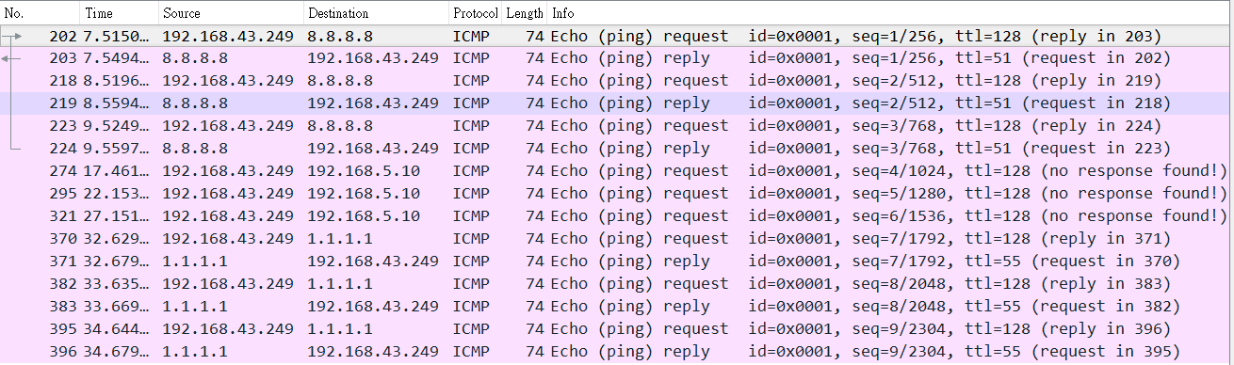

Slide 36
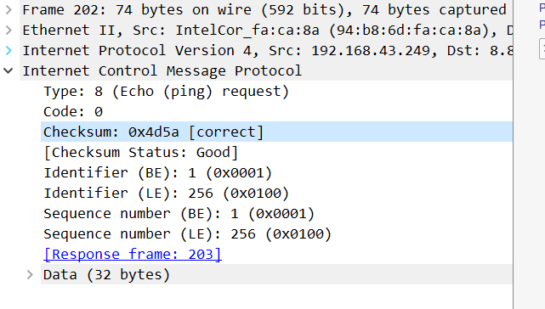

Slide 37
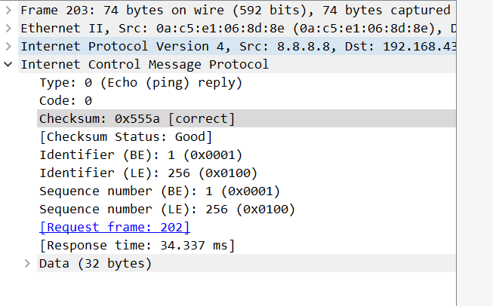

Slide 38
Tracert nkust 並察看結果

Slide 39
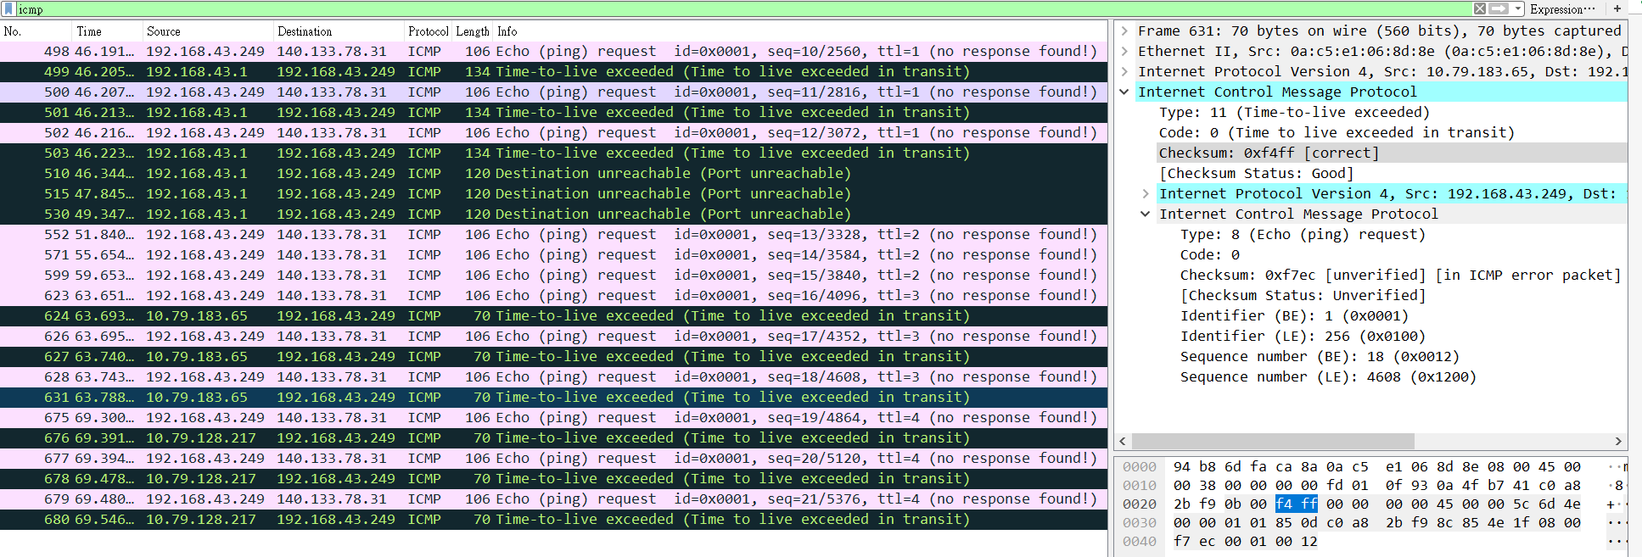

Slide 40
TCP Example

Slide 41
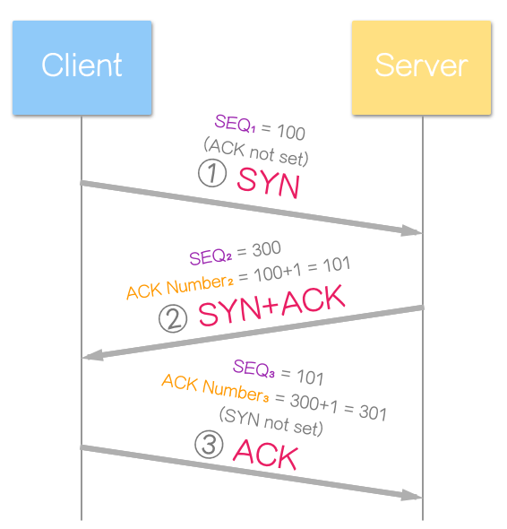
Client 向 Server 發送 SYN（Seq = 100，SYN = 1）
SYN+ACK
Server 收到 Client 請求，回覆（Ack=100+1）
Server 向 Client 發送 SYN（seq=300）建立連線請求
Client 向 Server 發送 ACK，用來確認雙方進入 ESTABLISHED
Seq 為請求序號 Ack 為確認序號
SYN、ACK 是 TCP 封包中的 控制位元 (Control Bits)
Notes:
https://notfalse.net/7/three-way-handshake

Slide 42
TCP Header
Offsets | Octet | 0 |  |  |  |  |  |  |  | 1 |  |  |  |  |  |  |  | 2 |  |  |  |  |  |  |  | 3
Octet | Bit | 0 | 1 | 2 | 3 | 4 | 5 | 6 | 7 | 8 | 9 | 10 | 11 | 12 | 13 | 14 | 15 | 16 | 17 | 18 | 19 | 20 | 21 | 22 | 23 | 24 | 25 | 26 | 27 | 28 | 29 | 30 | 31
0 | 0 | Source port |  |  |  |  |  |  |  |  |  |  |  |  |  |  |  | Destination port
4 | 32 | Sequence number
8 | 64 | Acknowledgment number (if ACK set)
12 | 96 | Data offset |  |  |  | Reserved 0 0 0 |  |  | N S | C W R | E C E | U R G | A C K | P S H | R S T | S Y N | F I N | Window Size
16 | 128 | Checksum |  |  |  |  |  |  |  |  |  |  |  |  |  |  |  | Urgent pointer (if URG set)
20 ... | 160 ... | Options (if data offset > 5. Padded at the end with "0" bytes if necessary.) ...

Slide 44
IP Example

Slide 45
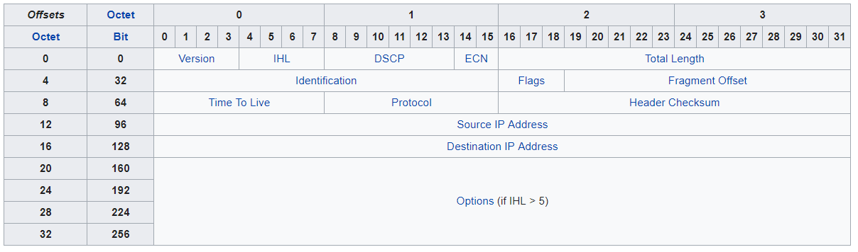

Slide 46
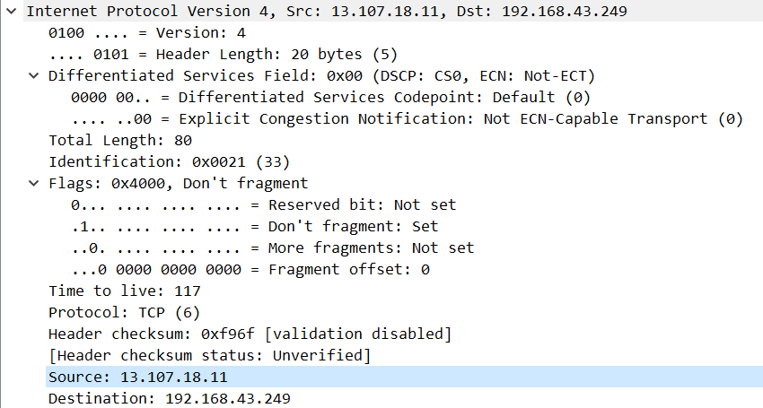
MF=1（後面還有分片）
MF=0（該資料包的最後一個分片）
DF=0（允許分片）

Slide 47
PUZZLE #3 ANN’S APPLETV
http://forensicscontest.com/2009/12/28/anns-appletv

Slide 48
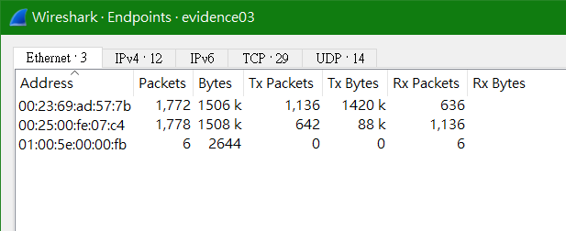
What is the MAC address of Ann’s AppleTV?
Notes:
00:25:00:fe:07:c4

Slide 49
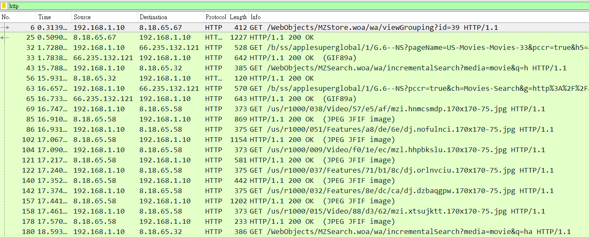
What User-Agent string did Ann’s AppleTV use in HTTP requests?
Notes:
User-Agent：AppleTV/2.4\r\n

Slide 50
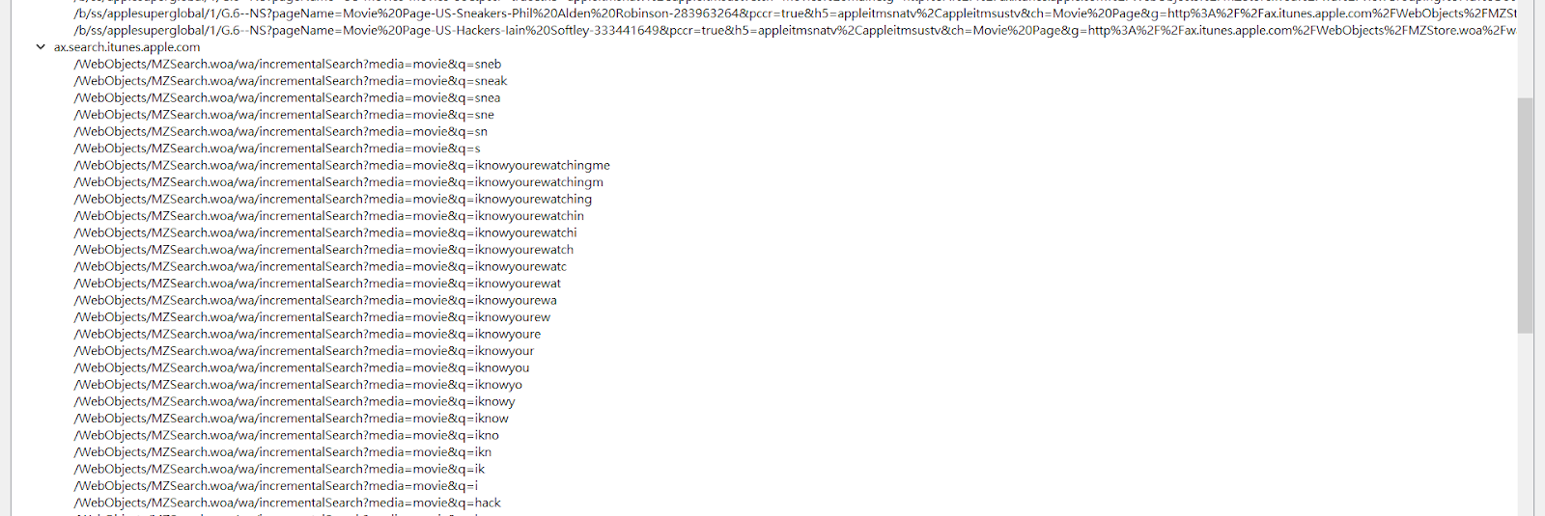
What were Ann’s first four search terms on the AppleTV (all incremental searches count)?
HTTP -> Requests
Notes:
hack

Slide 51
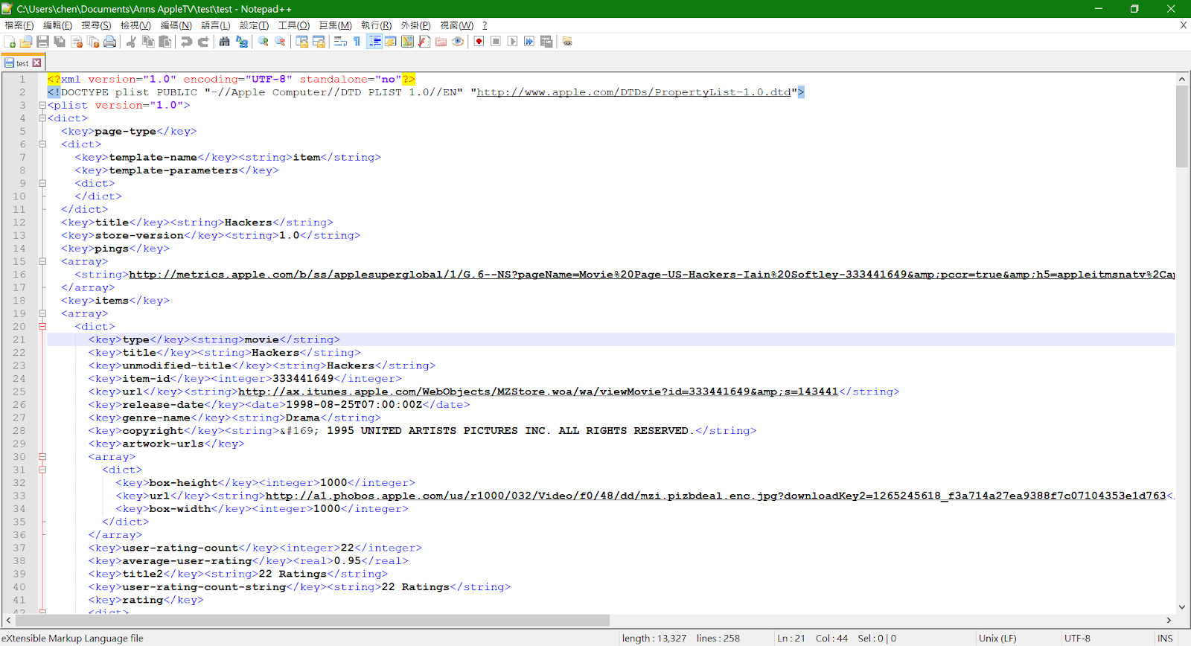
What was the title of the first movie Ann clicked on?
http.request.uri.query.parameter contains Hackers
Notes:
後面題目比較進階，所以就不接下去

Slide 52
https://notfalse.net/7/three-way-handshake
https://en.wikipedia.org/wiki/IPv4
https://github.com/CCH0124/Network/tree/master/wireshark
https://cch0124.github.io/arp/
http://forensicscontest.com/puzzles

